Slide 1
ACCIDENT PREVENTION GLASS
PRESENTED By:
ARAVINDHAN A
HARISH S S
VELUSAMY G
Guided By :
Mrs: LALITHA K
TEAM NO:2
COURSE CODE :22AIC10
COURSE TITLE: INTERNET OF THINGS LABORATORY

Slide 2
Abstract
•This project proposes a smart accident prevention glass using Arduino Nano to monitor and alert users of fatigue, drowsiness, or distraction.
•Equipped with sensors like an eye blink sensor, accelerometer, and alcohol sensor, the system detects impairments and triggers an alarm or vibration to warn the wearer.
•The compact design allows easy integration into wearable glasses, enhancing safety in workplaces and while driving by providing timely alerts to prevent accidents.

Slide 3
Objectives:
The primary objective of the Accident Prevention Glass is to enhance road safety by detecting potential distractions or fatigue in drivers and issuing timely alerts.
Using Arduino Nano, sensors, and other electronic components, this wearable device monitors driver behavior and external environmental conditions to reduce the risk of accidents by: Detecting signs of drowsiness (eye blinking rate, head nodding, etc.) Monitoring real-time environmental factors like light conditions or proximity to objects Providing audio, or vibration alerts to alert the driver when necessary The system is designed to be compact, lightweight, and cost-effective while maintaining reliable performance in accident prevention scenarios.

Slide 4
Components Required:
Transparent Glasses / Glasses frame
IR sensor
Arduino nano
Active Buzzer + Vibrator (5V)
Li-ion battery (3.7 V 180+ capacity)
Jumper wires
1 or 2 channel transmitter + receiver
Notes:
Transparent glasses

Slide 5
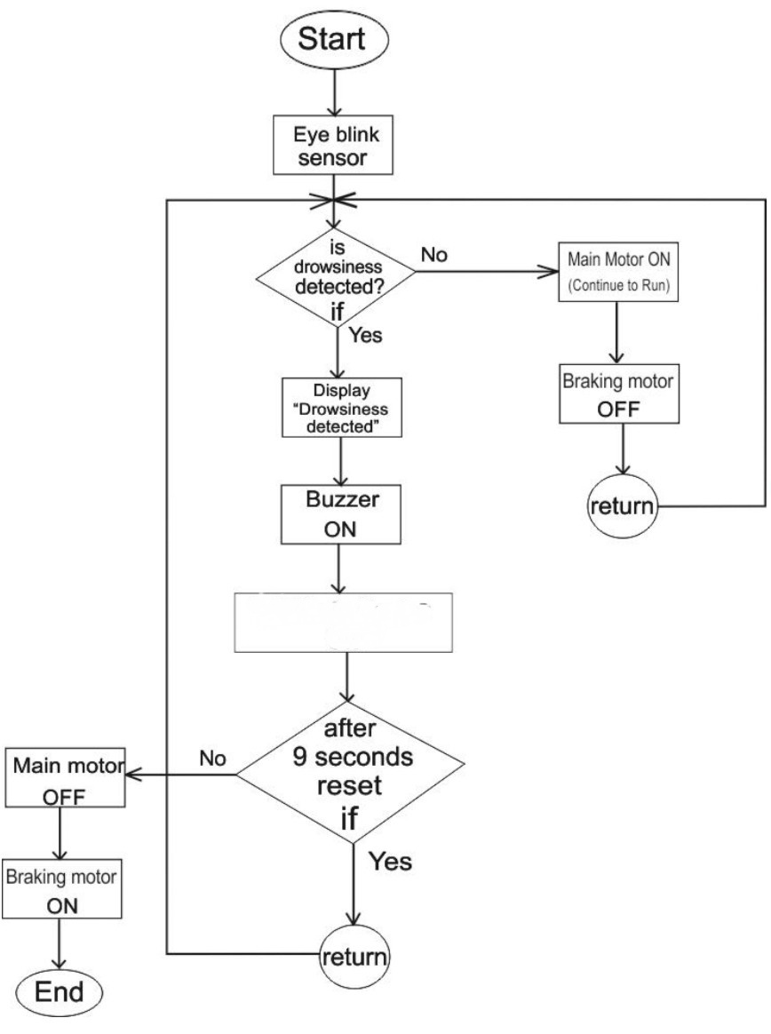
Flow Diagram:
VIBRATOR ON

Slide 6
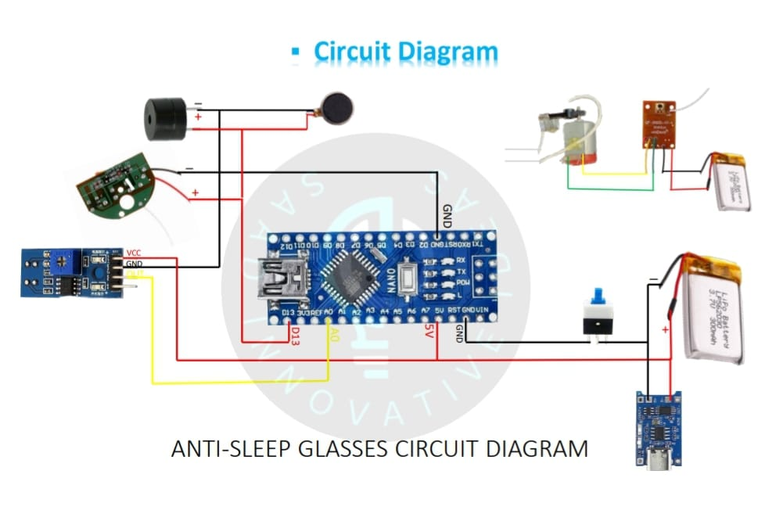
Design(optional):

Slide 7
Implementation: (Hardware or software)
Hardware: 1. Connect eye blink sensor to Arduino’s analog input pin. 2. Connect accelerometer to I2C or analog pins. 3. Connect vibration motor/buzzer to digital output pin. Software: 1. Write Arduino code to read sensor data. 2. Implement logic to detect abnormal conditions (e.g., low blink rate, sudden acceleration). 3. Trigger alerts using buzzer or vibration motor.

Slide 8
Thank u slide
THANK YOU

